Slide 1
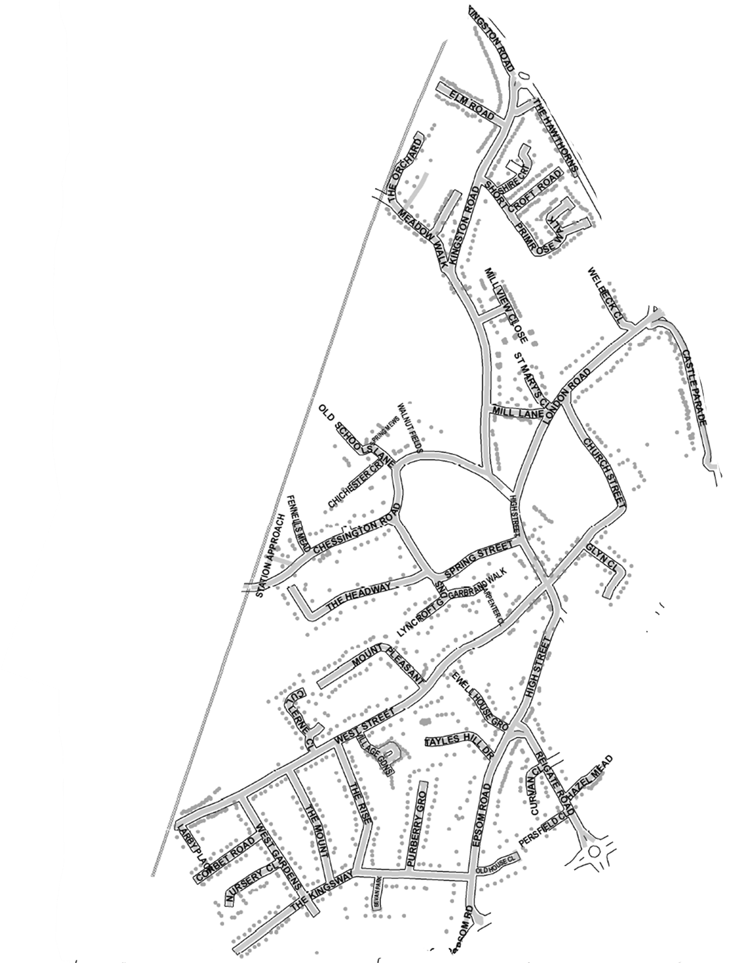
Route 27 Wednesday
COLBORNE CLOSE
(ALLEY)
GRANGE MANSIONS
27WE

